Slide 1
Marketing Campaign Performance Analysis
INFO4300 Final Presentation
Anugya Mishra

Slide 2
01
Research Questions
Notes:
katie

Slide 3
Research Question
How are the customers segmented based on various attributes, and how can we characterize and evaluate the clusters formed?

Slide 4
02
Presenting data

Slide 5
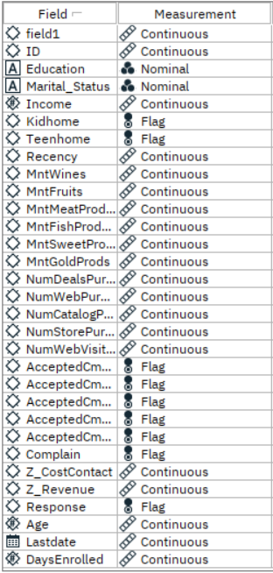
Dataset
2,239 records
28 variables
2 nominal
17 continuous
9 flag

Slide 6
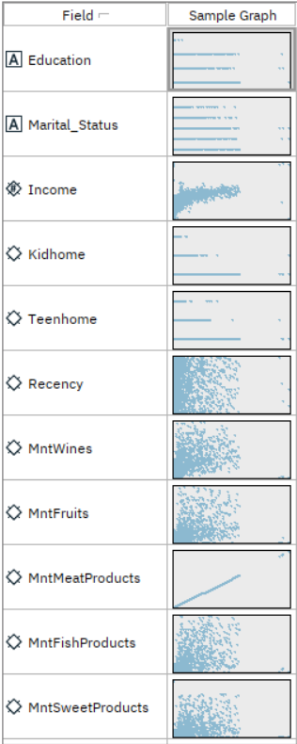
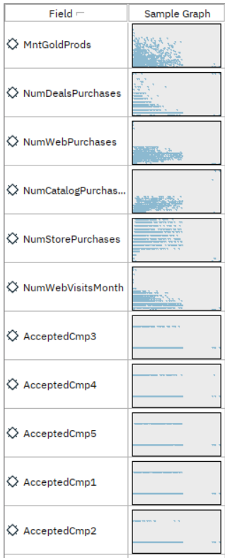
Relationships
*
*
*
*
*

Slide 7
03
Predictive Analytics: Cluster Analysis

Slide 8
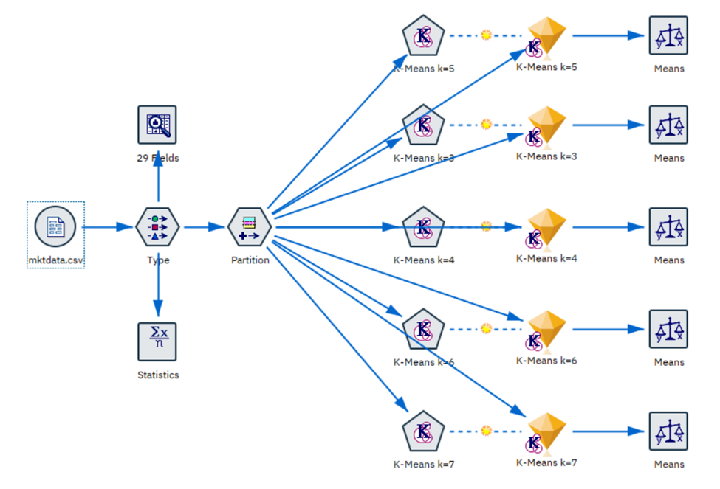
Cluster Analysis
5 Cluster Analysis models ranging from k=3 to k=7
Partition:
Training: 80%
Testing: 20%
Selected Cluster Sizes:
k= 3 to k=7

Slide 9
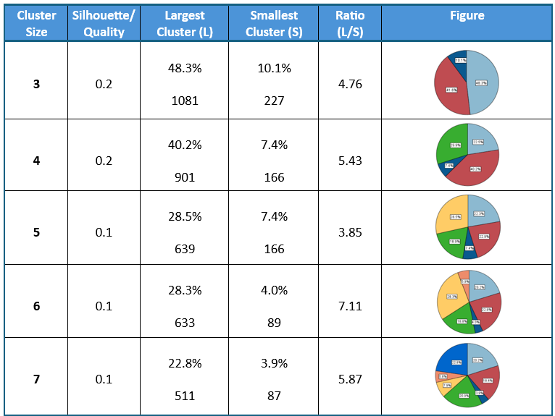
Results Summary
Best Cluster
3 Cluster Model
(Based on Cluster Quality)
Non-Important Predictors (Means)
Recency
Complain
Days enrolled (for some)
Notes:
Used the means node to understand whether each of these predictors were important in the formation of the clusters

Slide 10
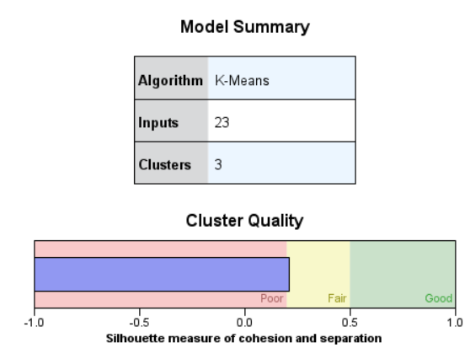
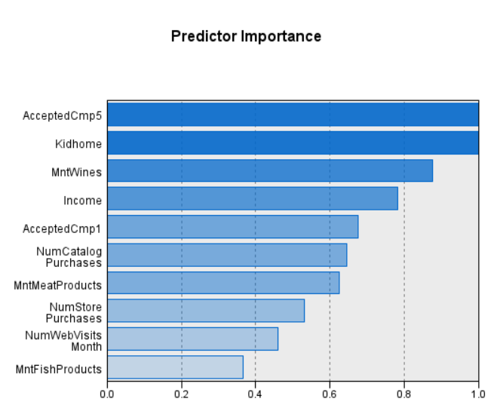
Best Cluster (k=3)
(After removing the
non-important predictors)

Slide 11
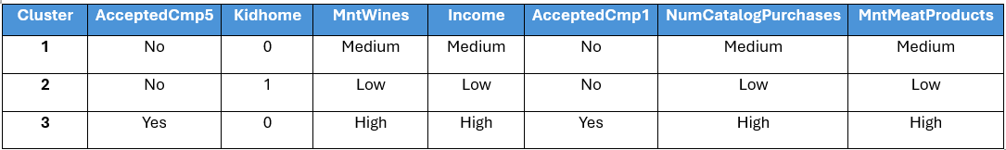
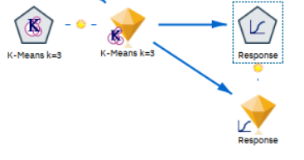
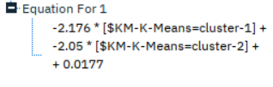
Defining Cluster Characteristics
Logistic Regression
Both are significant at 0.05 significance level.

Slide 12
04
Conclusion

Slide 13
Conclusion/ Business Implication
Perform sales analysis on the identified cluster to gain a better understanding of the company's customer base
Tailor future customer interactions and marketing campaigns with more relevant messages based on customer segmentation, with more focus on customers belonging to Cluster-3

